Slide 1
Chapter Accreditation Online System
Usage Tutorial
Department of Member Relations & Grants
National Children’s Alliance

Slide 2
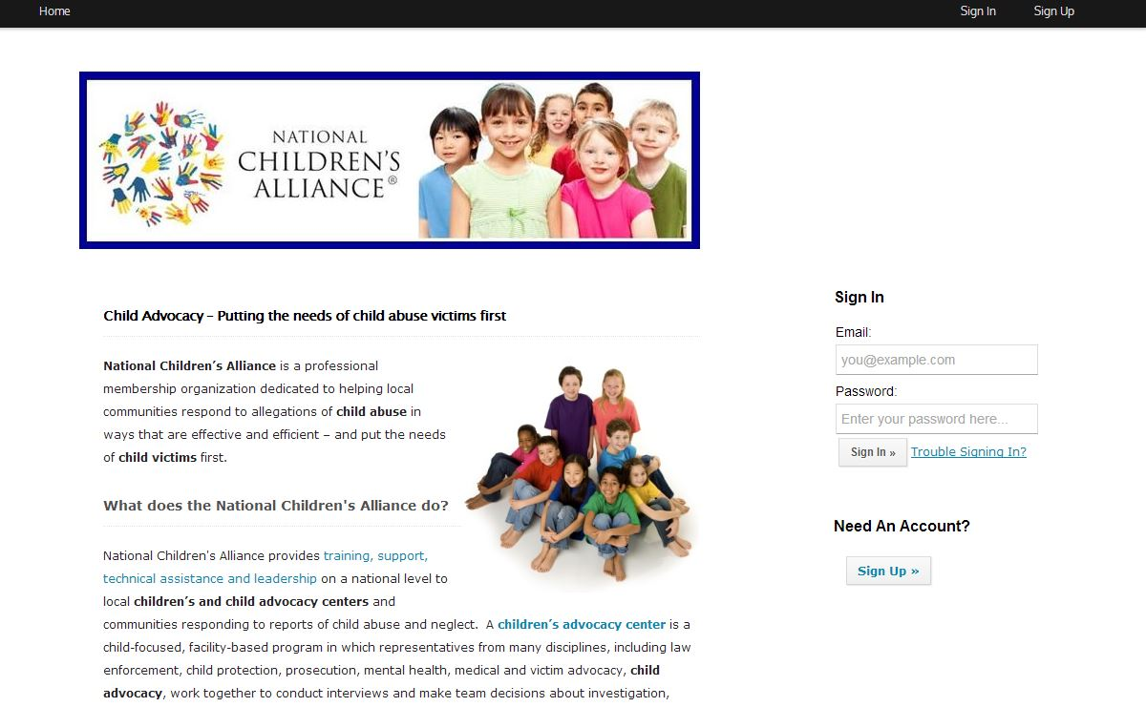
In order to access your online accreditation account, please contact accreditation@nca-online.org for the link.
This is an example of the homepage that you will see when you log into the Chapter Accreditation application website. For best compatibility, we recommend you use google chrome as your browser.
Notes:
When opening your browser, it is recommended that you use Google Chrome. You will be sent an email with a link to the application web page from accreditation@nca-online.org. When you click on the link, on the right side of your screen you will see the sign up button.

Slide 3
Making an Account You must make an account in order to use the online application system. Follow the arrow below to create an account when you are on the homepage.
Please make sure that you only create one account per organization. Each account will have the ability to add on multiple users once it is created.

Slide 4
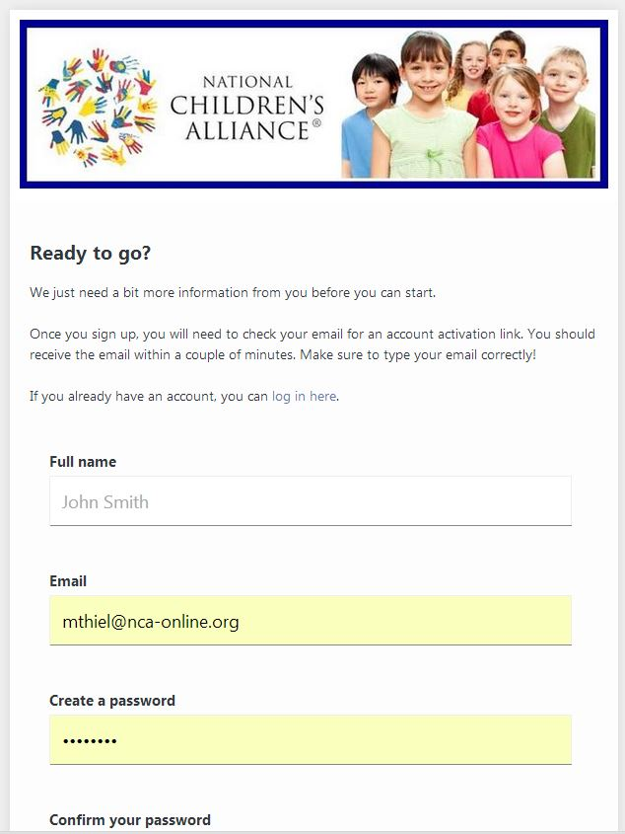
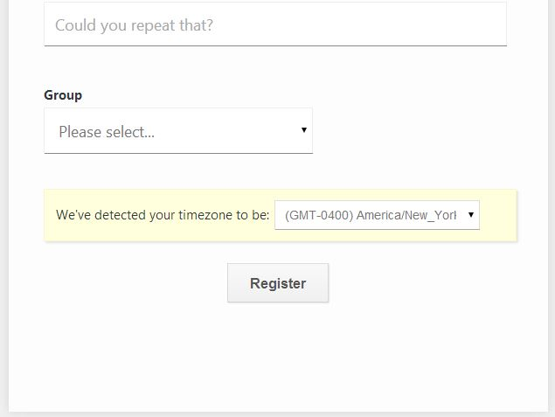
Registration
On this screen, please type the information that you wish to use for you account. PLEASE note that this email address will be the appointed email of receipt of any automated correspondence from the system (i.e. conference emails, links, etc.).
In the “Group” option, please use the drop down bar to select “Chapter Accreditation Applicants”
Notes:
All fields are required.

Slide 5
Forgot my password process
In case you have forgotten your password, please keep in mind that on the homepage there is a link next to the log in information that says “trouble signing in?”. Follow the link and select the option “click here to reset it”. Your password will be sent to you via the email address you provided on your account.
Notes:
On this page (when you click “trouble signing in?” on the home screen, you can reseet your password, activate your account (if you did not receive the original link when you registered) and check your account status (if it is active or not).

Slide 6
Please follow the instructions on this page. If you did not receive the confirmation email, please check your spam folder and reenter your email below.
Thank you for Registering
Notes:
These are the instructions that you will see once you select “register” on the previous screen.

Slide 7
Your confirmation email will look something like this…
Confirmation Email
Please follow the link in your confirmation email in order to go to your application.
Notes:
If you are using Outlook, you can do this by going to Tools-> Reviews and Alerts -> New Rule -> Move messages with specific words in the subject to a folder->next-> check off “with specific words in the subject”-> under “Step two” select “specific words” and type “_____”-> under “step two” select “specific folder” and select what folder you want it move to. Then select finish.

Slide 8
The link from your confirmation email will take you to this page. On it, please select Chapter Accreditation Application in the drop down window and click “Get Started”.
How to Start Your Application

Slide 9
Chapter Accreditation Applicant Home Page
Your Organization Name will appear here
Here you can download materials
Click here to update your name, email or reset password
Notes:
This slide shows the top half of your homepage. This homepage is where you will go to get resource materials (print the standards, accreditation and licensing agreement, policy on membership structure, sample of the application, etc.), check to see what parts of your application have been completed, add members for signatures, see the activity on the account, change your account setting, see the instructions and many more.
There is a news feed at the bottom of the page in which you can see the activity on the application (such as when someone uploaded a document, or completed a task, etc.)
To add a member, select “add member” on the right hand side navigation. This will take you to a page in which you put their name, email and what level of access they can have. They can either be an owner, access level member, or able to view only.
Organization Name- your organization name will appear after you complete the “Organization Information and Signatures” task ONLY after you have completed and saved the “Organization Information and Signatures” task.
How to

Slide 10
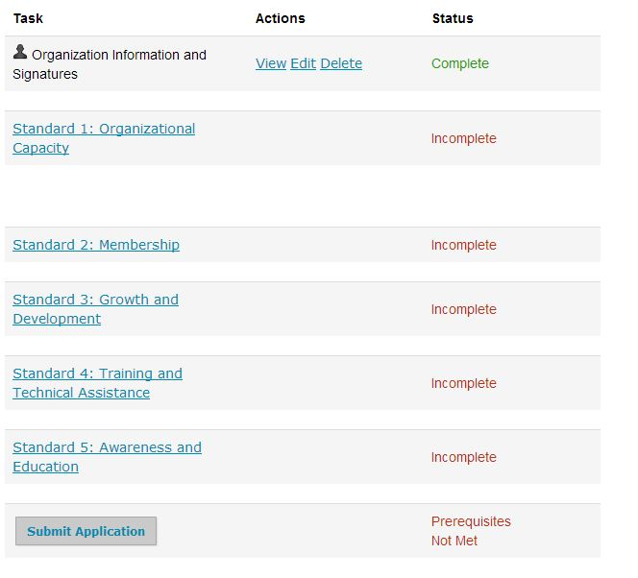
Your Tasks
After you start working on a task, the system will activate the following links. In this way, you can view the tasks you have started, delete it and edit it.
All the tasks that you finish by selecting the “save and exit” button will be marked as complete.
There are 6 Tasks to fill out in this application: Organization Information and Signatures and the 5 Standards (each with a specific focus). Once you have completed all the tasks, you will be able to submit your application. Please do not attempt to submit an application before completing all tasks.
Notes:
Note that beside the “submit application” button it says “Prerequisites Not Met”. This will change once you have filled out all tasks on the left hand side.
In order to submit a standard, you must click the name of the standard.

Slide 11
Resources Page
When you select “Resources” in the top right corner of your homepage, you will be taken to this screen in which you can download and print any materials to assist you while completing the application. Also located here is the Chapter Accreditation and License Agreement that you will download, sign, scan and upload to the homepage (as shown on the next slide).
Notes:
Instructions for how to upload the Chapter Accreditation and License Agreements are located on the home page.

Slide 12
Uploading your Chapter Accreditation and License Agreement
1. Find and download the agreements here under “Resources”
2. Print, sign and scan the documents to your computer.
3. Click “Add document” and upload the agreements here

Slide 13
Instructions for Signatures
In the first task, Organizational Information and Signatures, you will be required to submit signatures. Please follow the instructions above in order to draw your signature directly onto the given line on the page. (HINT- if you don’t see a line or want to redo a signature, click the “clear” button.)

Slide 14
Instructions for Signatures and Adding Members
If you need signatures from multiple members, you can invite them to have access to your online account and sign the page themselves. To do this, select “Add Member”. The system will then prompt you to enter their first and last name, email address and access level. Select “standard” for their access level. This person will be sent an email with the log in information so they can log into the application and sign the corresponding part of the application themselves.

Slide 15
Navigation Tips
Select “Next” in order to go to the next page of this form
Select “Save & Continue Editing” if you want to save and come back later (or just save as you go). We recommend you frequently save any changes you make as you go.
Notes:
This is an example of what your tasks will look like while completing them. Notice that for Standard 1, it asks you for your organizational structure and from there will take you to the corresponding form.
Please note that there is no “save and exit” button because this is not the last page of the task. Once you have filled out all the pages, then you will see the “save and exit” button on the last page. You must fill out all in order for the task to be marked as “complete”.

Slide 16
Navigation Tips
In many of the tasks, if you select no, a “Please explain” text box will appear.
In all tasks, there is a place to upload the applicable documents that are corresponding to each component for each standard. In order to upload the document, select “Choose File” and upload from your computer. PLEASE remember to name the file as it appears above the upload bar for each document (i.e. “1A Non-Profit Corporate Certificate from State”).
Notes:
While answers in the “Please explain” box are not mandatory, it may be helpful in order to explain why you selected no (i.e. specific situations). It will appear for all “no” responses.
For the uploads, please name the file that you are uploading as it appears on each upload bar. For example, in this component, you will name the file “1A Non-Profit Corporate Certificate from State”.

Slide 17
When you have finished a task…
When you have finished a task, select “Save and Exit” and you will be taken back to your home page. The task will then be marked as complete.

Slide 18
Submit your application
Once you have completed all tasks (6 total) AND uploaded your Chapter licensing and Accreditation Agreements, you may submit your application. Please note that you cannot go back and edit once you submit. You may, however, go back and view what you have submitted.

Slide 19
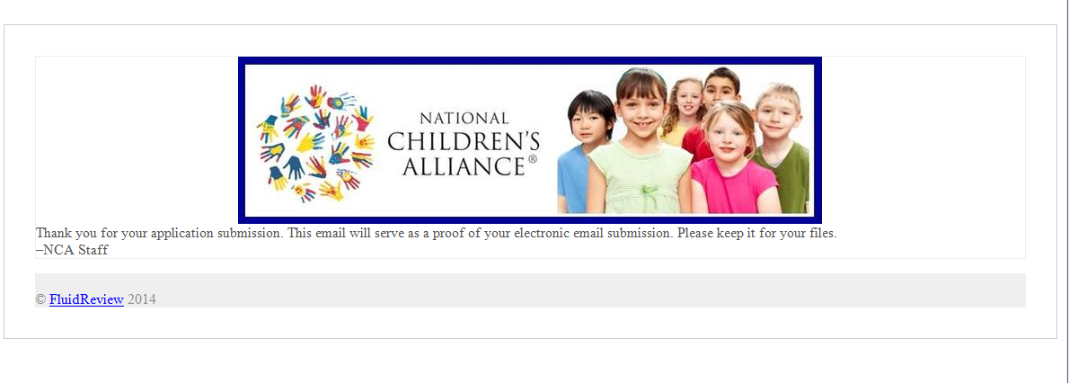
Confirmation Email
You will be sent a confirmation email upon completion of your application. Please keep this for your records. If you have any questions, please contact Accreditation at accreditation@nca-online.org

