Slide 1
Examples of Proof of Payment - Personnel

Slide 2
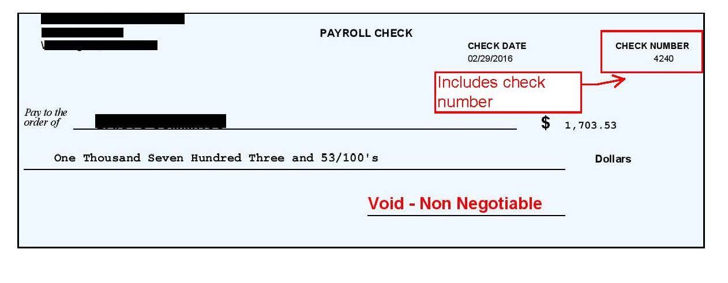
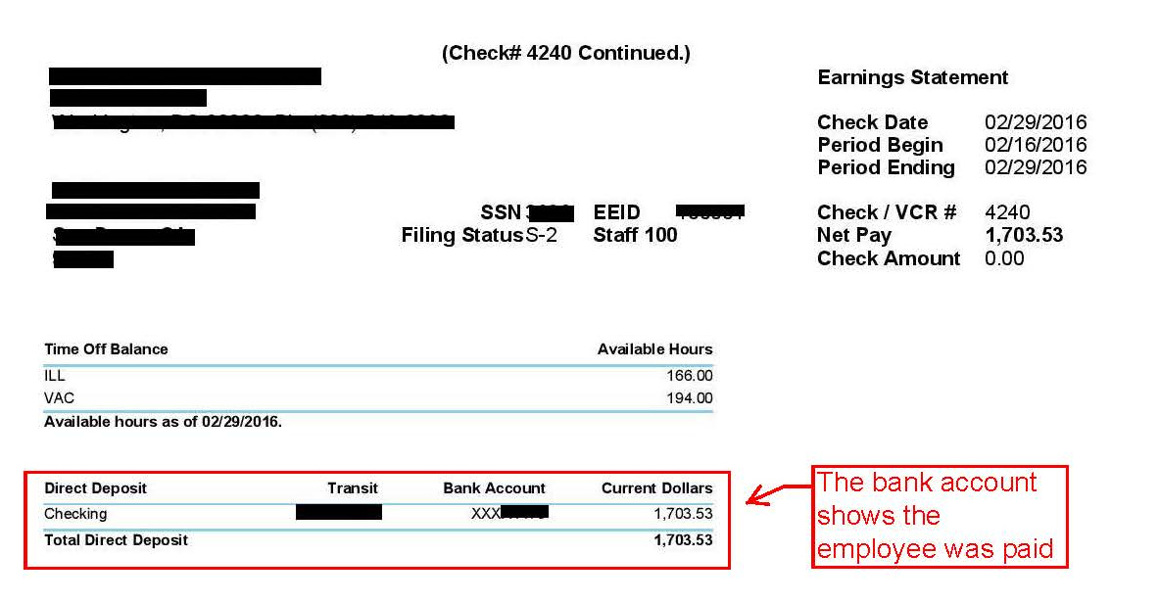
Example of Direct Deposit 1- from a full service payroll company such as ADP, Paycheck, etc.
For personnel where the individual is paid
through direct deposit the easiest way to
show the correct documentation is through a
paystub. The paystub shows the routing
and bank account number to prove the
individual as paid. This step ensure that
employees are being paid. Please remember to black out any confidential information
(i.e. social security number, bank account
number) However this document does not
provide info for the detailed deductions
(such as payroll taxes and benefits),
only net payroll information. Thus it
needs to be combined with Direct Deposit detail on the next slide.

Slide 3
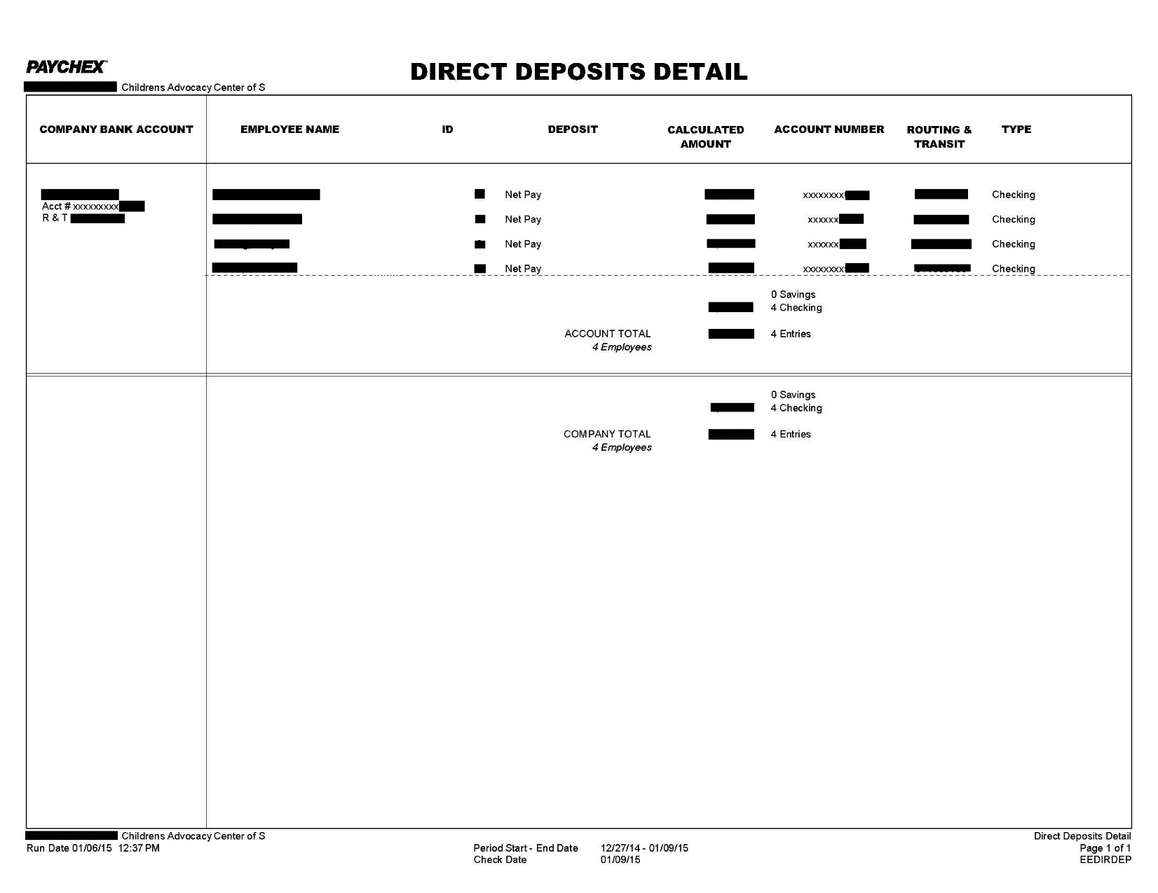
Example 1 of Direct Deposits Detail
If paystubs are not available a ACH or
Direct Deposit Detail may be submitted.
ACH and Direct Deposit Detail’s contain
the required information since they
show that the direct deposit has gone
through with the listing of the routing
and account number. This step ensure that
employees are being paid. Please remember
to black out any confidential information
(i.e. social security number, bank account
number)

Slide 4
Example of Direct Deposit 2- printed for the employee and sent to the bank to request the Direct Deposit
For personnel where the individual is paid
through direct deposit the easiest way to
show the correct documentation is through a paystub. However this paystub does not show the routing and bank account number so to prove the individual was paid you must provide a copy of the grantee bank statement as well. If multiple payroll checks are deducted from the grantee bank statement in one lump sum, attach a copy of the payroll earnings report indicating the total amount (see next slide). Please remember to black out any confidential information (i.e. social security number, bank account number)

Slide 5
Example 2 of Payroll Earnings Report
This report would prove the paystub on the previous slide was part of a larger payroll run and support the one lump sum being deducted from the bank statement for payroll. If multiple payroll checks are deducted from your bank statement in one lump sum, attached a copy of the payroll earnings report or payroll register indicating the total amount. Please remember to black out any confidential information (i.e. social security number, bank account number)

Slide 6
Fringe Benefit Reporting
FICA taxes, unemployment taxes, workers compensation insurance and any other type of insurances, PAID by the employer only, must clearly be defined (for each employee; not in total) on a payroll earnings report, general ledger or other support documentation. NCA can only reimburse for gross salaries (employer FICA taxes and employer paid benefits).
Taxes and all benefits must be allocated to the grant in the same manner as salaries and only for employees approved under the grant. (Example: if 20% of salaries were allocated for an employee then only 20% of taxes and benefits can be allocated.)

Slide 7
Reimbursement Proof of Payment Examples

Slide 8
EXAMPLE OF ELECTRONIC BILL PAY SERVICE
This report would prove the a vendor has been paid through an online bill pay service. A copy of the detailed invoice and bank statement proving the amount of the invoice was deducted would be needed. Please remember to black out any confidential information.

Slide 9
Example of Direct Deposit- Vendor Invoice
For some larger organizations like
hospitals the direct deposit information
may show up as a vendor invoice. The
following example is allowable since it
shows the payment number, “EEE”,
information about the payment being issued,
and payment date.

Slide 10
Example of Reimbursement Canceled Check
If someone is reimbursed through a check
a copy of the canceled check will need to be
provided to ensure that the individual receiving
the check deposited the money. Both front and back of check needs to be provided.
REMINDER: You should NEVER sign your own check or initiate a direct deposit without written board approval.

Slide 11
Proof of Payment Examples for Purchases

Slide 12
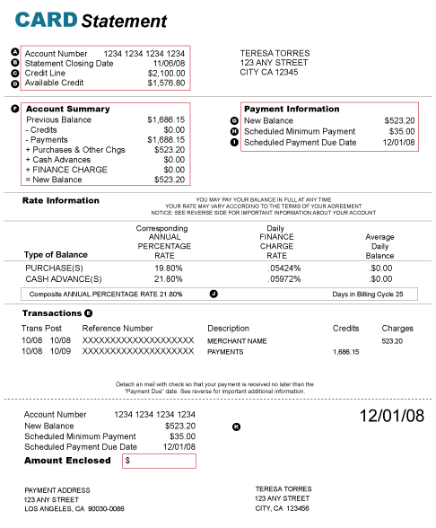
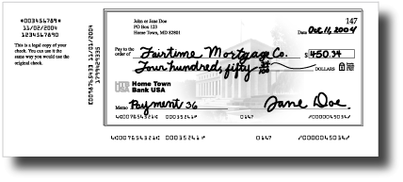
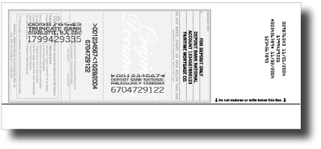
Examples of Items Purchased with Credit Cards
If something is purchased through a company credit
card we will need to see the receipt (proof of
expense), the credit card statement, and proof
that the credit card was paid. This can be through
a canceled check, or bank statement showing
the credit card was paid.
If the purchase was made by an individual’s credit
card we will still need receipts, proof the credit
card was paid and proof the individual was
reimbursed.

Slide 13
Examples of Items Purchased with Checks
If something is purchased through a check
we will need to see the receipt (proof of
expense) and a copy of the canceled check.

